Slide 1
Investment Appraisal of Cement Mixer Hire Using Monte Carlo Simulation
Roshan Joji
MATH525

Slide 2
Decision Context & Objective
Purchase cement mixer at initial cost of £33,000.
Hire out at £150/day, for 2 years.
Sell at end of Year 2.
Decision required: should we pursue this investment opportunity?

Slide 3
Outcome Measure: Net Present Value (NPV)
Net present value (NPV)
The present value equivalent of all cash inflows, minus all cash outflows, associated with an investment (Andersson, 2000).
From an economic standpoint, if NPV > 0, the investment creates value for the company and should be accepted. If NPV < 0, the investment destroys value and should be rejected (Andersson, 2000).
What does it mean?
NPV can be used to determine wealth creation and value for a company and can be used to prioritize investments (C. Bertrand, 2013).
Units
NPV is measured in units of currency (in this case, £).

Slide 4
Key Uncertain Drivers of NPV
Hire Days Per Year
Maintenance Cost Y1
Maintenance Cost Y2
Resale Value

Slide 5
Assumed Probability Distributions
Number of Hire Days Per Year | Probability
125 days | 0.2 (20%)
150 days | 0.3 (30%)
175 days | 0.5 (50%)
Maintenance Cost Y1 | Probability
£1200 | 0.4 (40%)
£2500 | 0.5 (50%)
£4000 | 0.1 (10%)
Maintenance Cost Y2 | Probability
£1200 | 0.2 (20%)
£2500 | 0.6 (60%)
£4000 | 0.2 (20%)
Resale Value | Probability
£5000 | 0.7 (70%)
£7000 | 0.3 (30%)
Management-estimated discrete probabilities

Slide 6
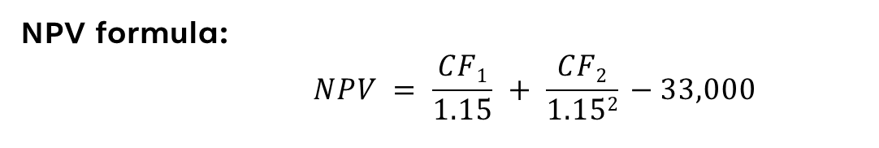
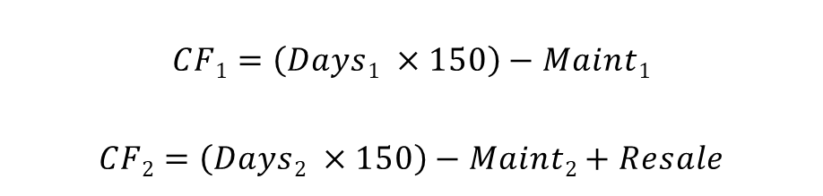
Outcome Formulation
NPV formula:
$$NPV = \frac{CF1}{1.15} + \frac{CF2}{1.152} −33,000$$
(Andersson, 2000)
Assumed discount rate of 15%.
Cash Flow Formulas:
$$CF1=\left(Days1 ×150\right)−Maint1$$
$$CF2=\left(Days2 ×150\right)−Maint2+Resale$$

Slide 7
Why use a simulation?
Multiple uncertain input variables with known probabilities
Discrete, non-normal outcome distributions
Management interest in risk as well as expected return
Analytical solution possible but impractical and less precise

Slide 8
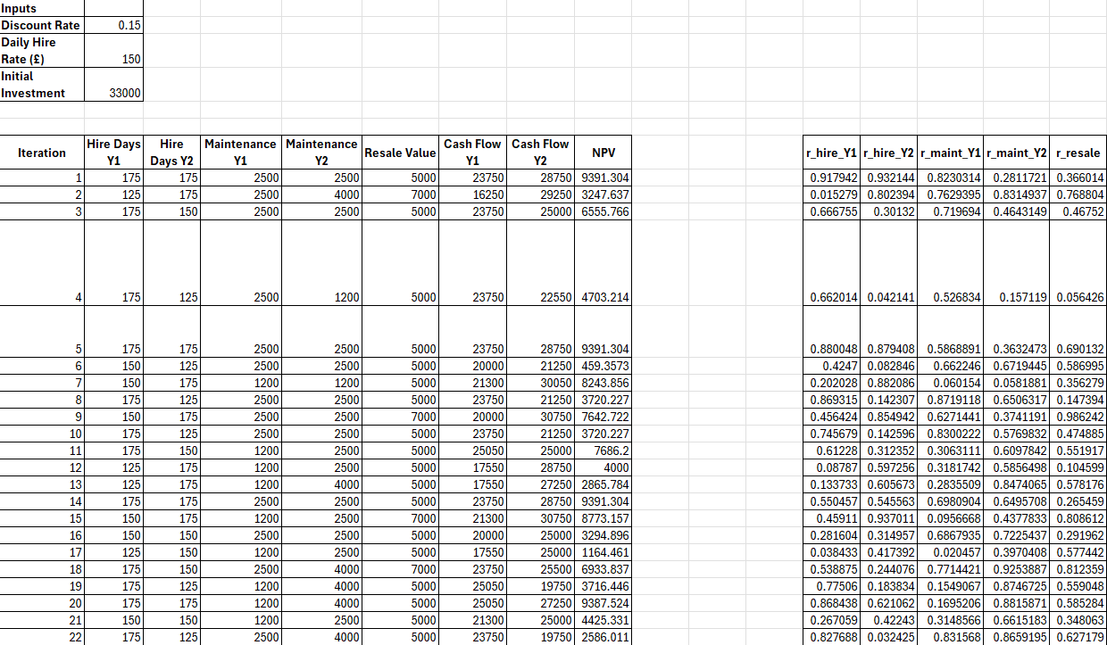
Simulation set-up
Constants used within the simulation.
Each row (iteration) is one possible future scenario within the simulation.
Cash flow and NPV values were calculated using the model equations.
The simulation was performed using a random sampling method.
This simulation was performed with 15,000 independent iterations

Slide 9
Simulation Logic
One random draw per uncertain variable.
Probabilities implemented via cumulative thresholds.
Same sampling logic applied independently in each iteration.
Uniform(0 , 1) random draws
Hire Days Y1: Mapping random draw to outcome
=IF(M8<0.2,125,IF(M8<0.5,150,175))

Slide 10
Simulation Results: Summary Statistics
Metric | Value | Interpretation
Mean NPV | £5,900 | Expected Value Created
Median NPV | £6,130 | “Typical” Outcome
Probability of NPV < 0 | 0.06 (6%) | Risk of Loss
5th Percentile NPV | -£675 | Downside Risk
95th Percentile NPV | £10,904 | Upside Potential
Based on 15,000 iterations (15% discount rate)

Slide 11
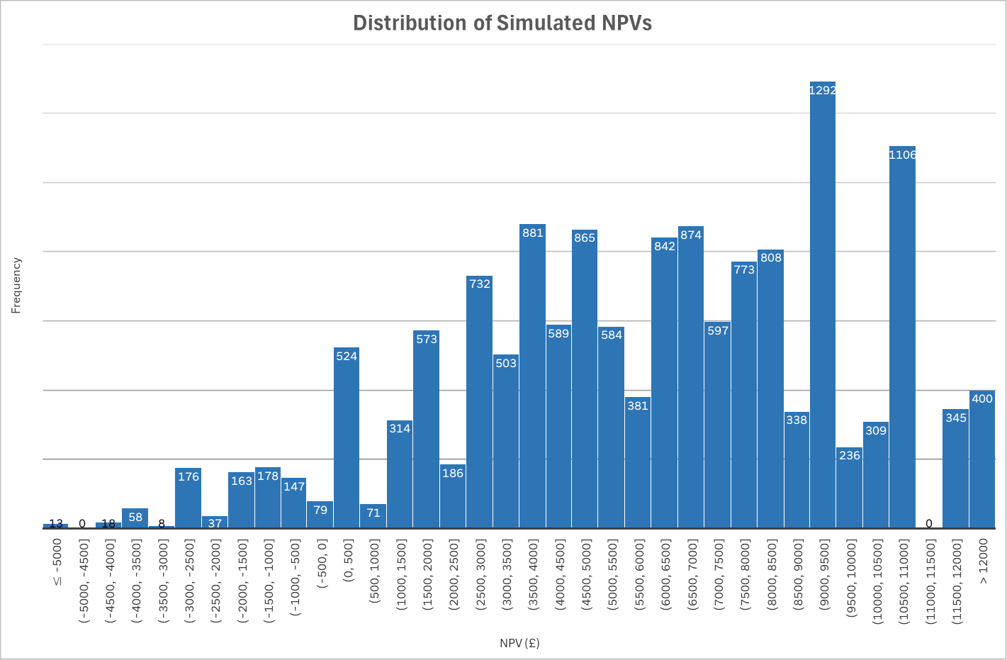
Simulation Results: Histogram

Slide 12
Analytical Alternative to Simulation
Analytical Approach | Simulation Approach
Replace uncertain inputs with expected values (probability-weighted averages). Calculate a single NPV. Simpler and faster to achieve. Impractical when such large numbers of potential outcomes exist. | Explicitly models uncertainty. Produces a distribution of NPVs. Quantifies downside risk and upside potential. More informative for decision-making.

Slide 13
Final Recommendation
Proceed with the investment
Positive expected NPV (£5.9k at 15% discount rate).
High likelihood of value creation (94% of simulation outcomes positive).
Limited downside risk (5th percentile NPV = -£675).
Meaningful upside potential (95th percentile NPV = £10.9k).
Short two-year timespan and resale value provide additional downside protection.

